Slide 1


WAREHOUSE OPERATIONS
Monthly Report
November 2021
STORAFLOW • MEKARJAYA
Storaflow Mekarjaya — Confidential
November 2021 · 1

Slide 2
Agenda
01
Summary KPI
02
Inbound
Ringkasan pencapaian KPI vs target bulan November
Summary performa & issue proses inbound
03
Occupancy
04
Accuracy
Kondisi occupancy storage per area (Desember)
Hasil accuracy per WH client bulan November
05
Outbound
06
Retur
Summary performa & issue proses outbound
Summary performa & issue proses retur
Storaflow Mekarjaya — Confidential
November 2021 · 2

Slide 3
SECTION 01
Summary KPI
INBOUND
Inbound Regular 0
Target 99.50%
—
Inbound Gimmick & TX 0
Target 99.50%
—
OUTBOUND
Outbound Regular 0
Target 99.90%
—
Outbound Instant & Same Day 0
Target 99.90%
—
RETUR
Unboxing + Confirm 0
Target 100.00%
—
Doc to GRN 0
Target 99.50%
—
Doc Video 0
Target 100.00%
—
Storaflow Mekarjaya — Confidential
November 2021 · 3

Slide 4
SECTION 02 · INBOUND
Scorecard Inbound Summary
Summary
Total | On time | Late | Remark
0 | 0 | 0 | 0
% | — | — | —
KPI | 99.50% | 0.50% | 99.50%
Regular
Total | On time | Late | Remark
0 | 0 | 0 | 0
% | — | — | —
KPI | 99.50% | 0.50% | 99.50%
Gimmick
Total | On time | Late | Remark
0 | 0 | 0 | 0
% | — | — | —
KPI | 99.50% | 0.50% | 99.50%
Remark % = (on time + late with a remark) ÷ total · green = meets the KPI
Storaflow Mekarjaya — Confidential
November 2021 · 4

Slide 5
SECTION 02 · INBOUND
Scorecard Inbound Issue
No issue recorded for November 2021.
Storaflow Mekarjaya — Confidential
November 2021 · 5

Slide 6
SECTION 03 · OCCUPANCY
Occupancy Summary
Data as of 17 Oktober 2026
Storage Cool
SCL
Storage Dry
SDR
Storage Display
SDP
Storage Packing
SPK
Storage Return
SRT
Storage Office
SOF
PALLET
29%
PALLET
84%
PALLET
100%
PALLET
88%
PALLET
0%
PALLET
0%
SHELF
76%
SHELF
77%
SHELF
72%
TABLE
12%
SHELF
0%
SHELF
0%
119
56
330.7
400
22
483.2
10
54
214.1
24
66
24
7
10
43.2
1
0
36.4
PALLET
SHELF
CBM
PALLET
SHELF
CBM
PALLET
SHELF
CBM
PALLET
TABLE
CBM
PALLET
SHELF
CBM
PALLET
SHELF
CBM
Storaflow Mekarjaya — Confidential
November 2021 · 6

Slide 7
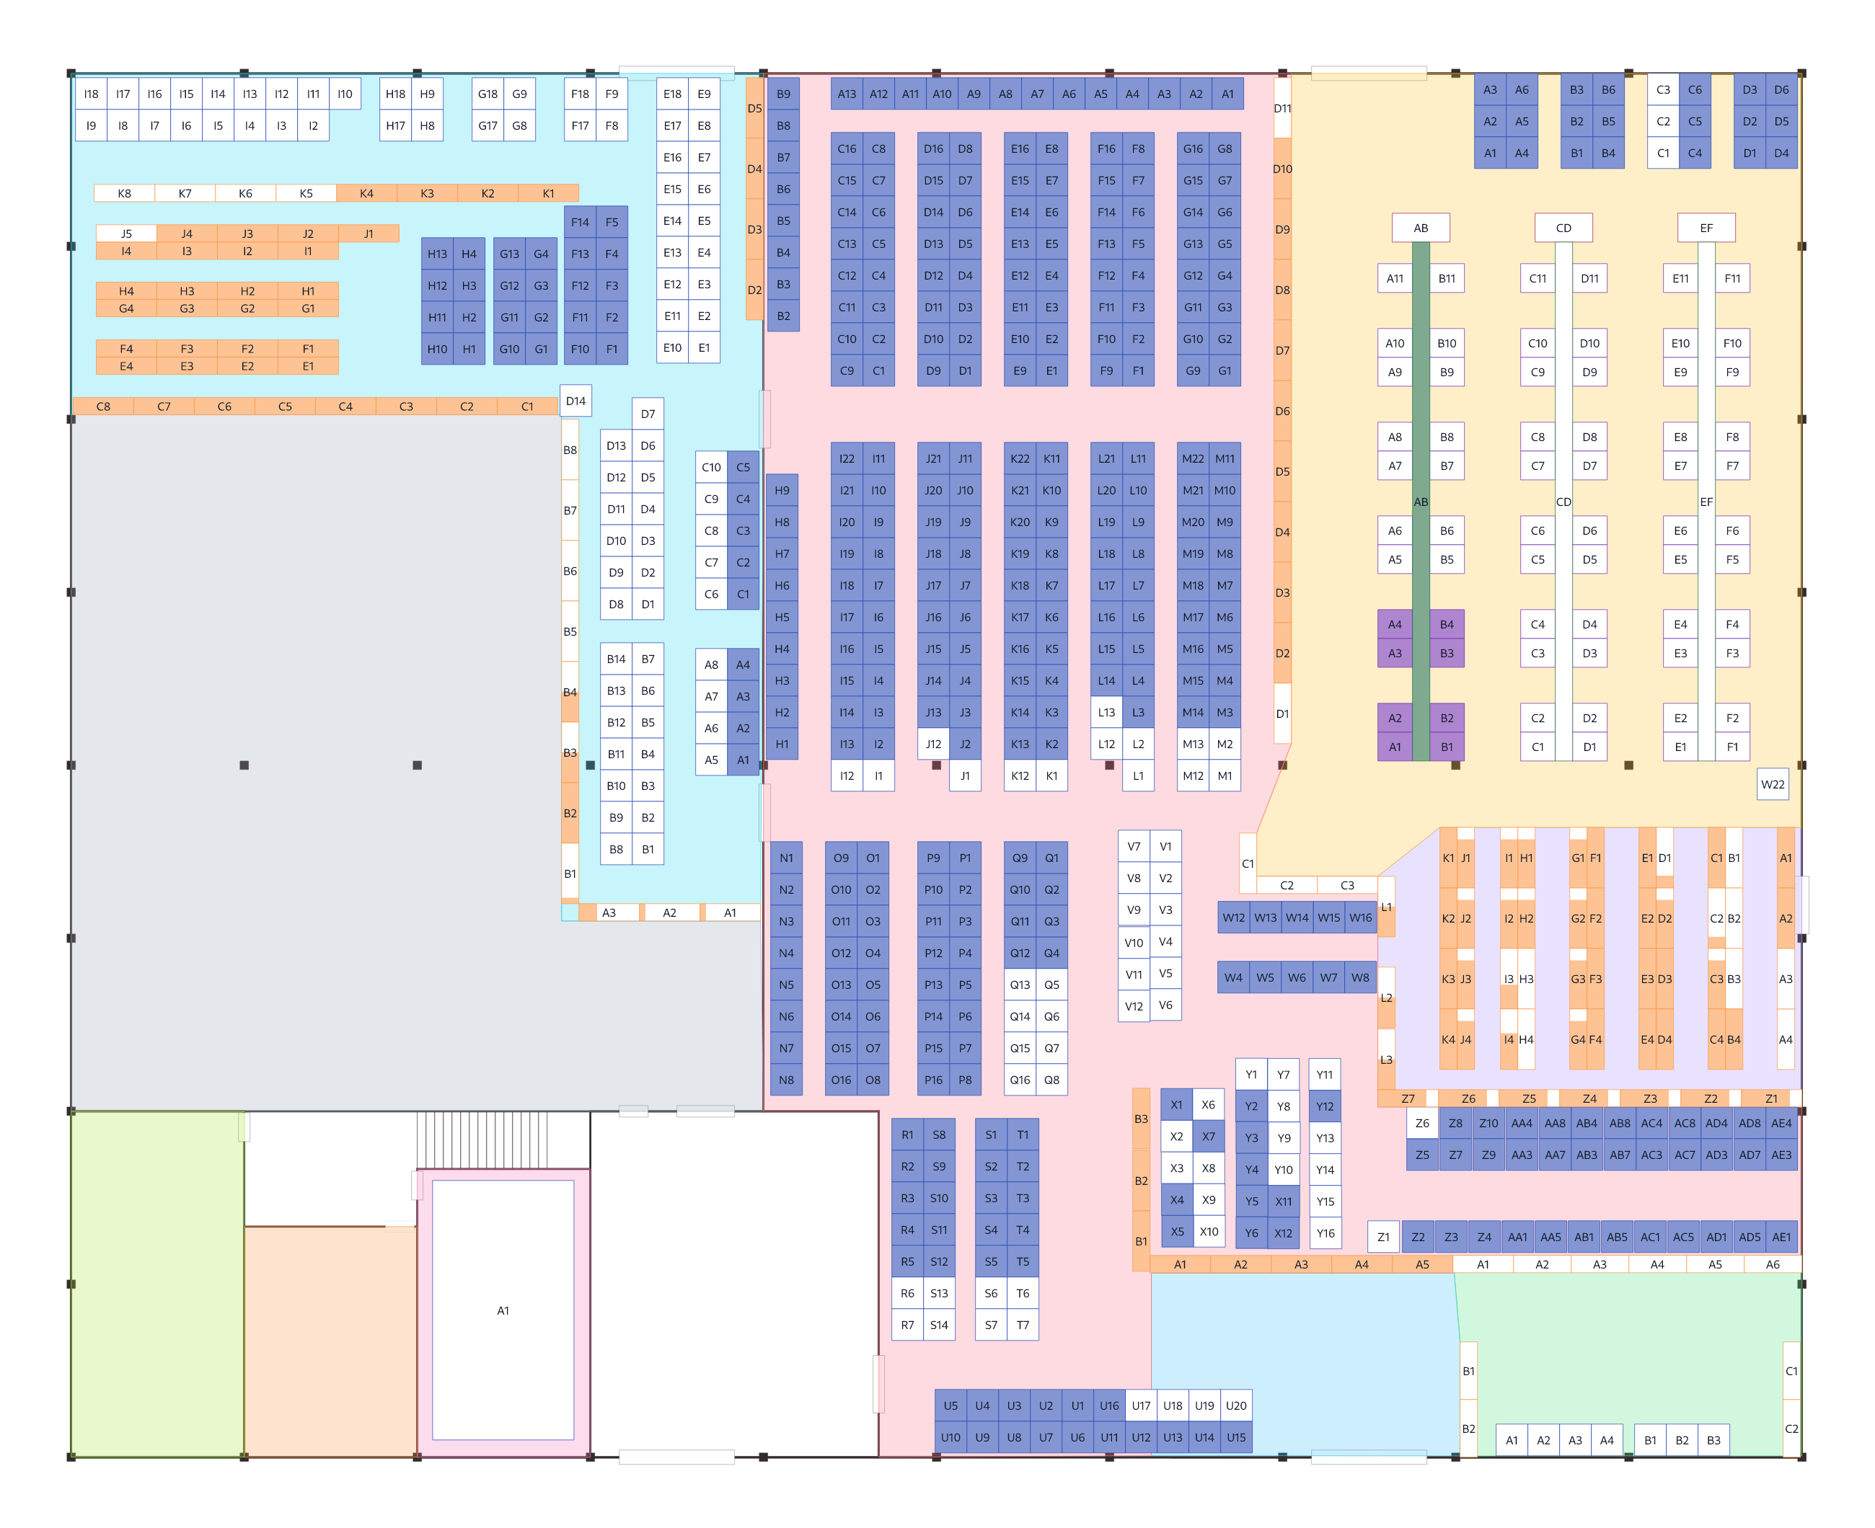
SECTION 03 · OCCUPANCY
Occupancy Layout
Storaflow Mekarjaya — Confidential
November 2021 · 7

Slide 8
SECTION 04 · ACCURACY
Accuracy Mekarjaya — November 2021
No stock-take result saved for November 2021.
Storaflow Mekarjaya — Confidential
November 2021 · 8

Slide 9
SECTION 05 · OUTBOUND
Scorecard Outbound Summary
Summary
Total | On time | Late | Remark
0 | 0 | 0 | 0
% | — | — | —
KPI | 99.90% | 0.10% | 99.90%
Regular
Total | On time | Late | Remark
0 | 0 | 0 | 0
% | — | — | —
KPI | 99.90% | 0.10% | 99.90%
Instant
Total | On time | Late | Remark
0 | 0 | 0 | 0
% | — | — | —
KPI | 99.90% | 0.10% | 99.90%
Remark % = (on time + late with a remark) ÷ total · green = meets the KPI
Storaflow Mekarjaya — Confidential
November 2021 · 9

Slide 10
SECTION 05 · OUTBOUND
Scorecard Outbound Issue
No issue recorded for November 2021.
Storaflow Mekarjaya — Confidential
November 2021 · 10

Slide 11
SECTION 06 · RETUR
Scorecard Return Summary
Input
Total | On time | Late | Remark
0 | 0 | 0 | 0
% | — | — | —
KPI | 100.00% | 0.00% | 100.00%
GRN
Total | On time | Late | Remark
0 | 0 | 0 | 0
% | — | — | —
KPI | 99.50% | 0.50% | 99.50%
Video
Total | Yes | No | Remark
0 | 0 | 0 | 0
% | — | — | —
KPI | 100.00% | 0.00% | 100.00%
Remark % = (on time + late with a remark) ÷ total · green = meets the KPI
Storaflow Mekarjaya — Confidential
November 2021 · 11

Slide 12
SECTION 06 · RETUR
Scorecard Return Issue
No issue recorded for November 2021.
Storaflow Mekarjaya — Confidential
November 2021 · 12

Slide 13
THANK YOU
Terima Kasih
Monthly Report · November 2021
STORAFLOW • MEKARJAYA
Storaflow Mekarjaya — Confidential
November 2021 · 13

